Slide 1


Group 5

Slide 2
What is it?
A competitive networked multiplayer race game for 3-5 players.
Simultaneous, symmetric gameplay.
PC standalone.
Approx. 6 minutes of desired playtime per round.

Slide 3
Who’s it for?
Males aged 10-15
Fans of mascot-driven games (e.g. Ratchet and Clank, Sonic etc.).
Interested in multiplayer competitive skill-based games (TF2).

Slide 4
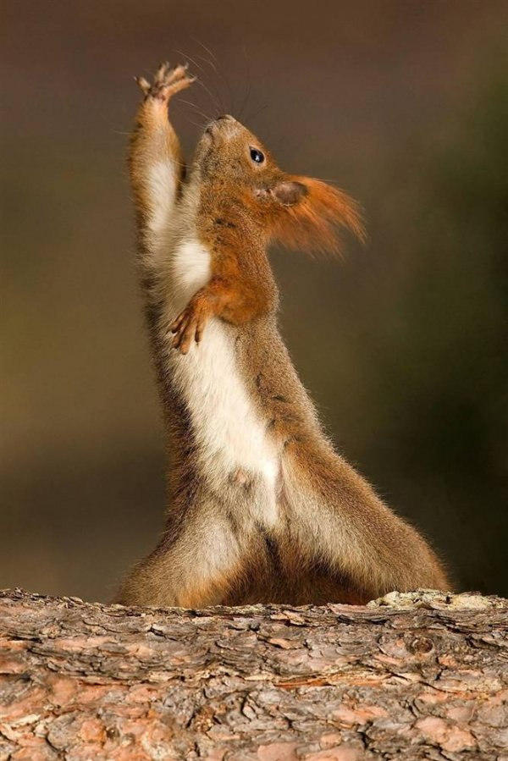
Emotions and Challenges
Tension and release
Fiero
Physical challenges
Twitch
Dexterity
Precision
Mental challenges
Prediction
Strategy
Memorisation
Coordination

Slide 5
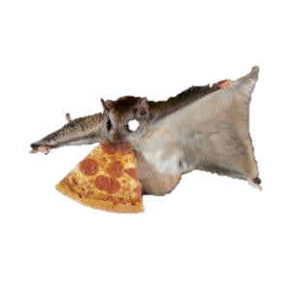
What do they do?
(PICTURES EXPLAINING CORE GAME LOOP – REFER TO SPEAKER NOTES)
Overall goal:
Obtain 3 nuts before anyone else.
Descend the hill
Grab a nut
Return to base
Notes:
Core game loop:
Observe the level and potential paths through it.
Decide on the optimal path through the map.
Decide the method to achieve that route (ground movement/grapple/glide)
Execute.
Overall goal:
Obtain 3 nuts before anyone else.
Descend the hill
Grab a nut
Return to base

Slide 6
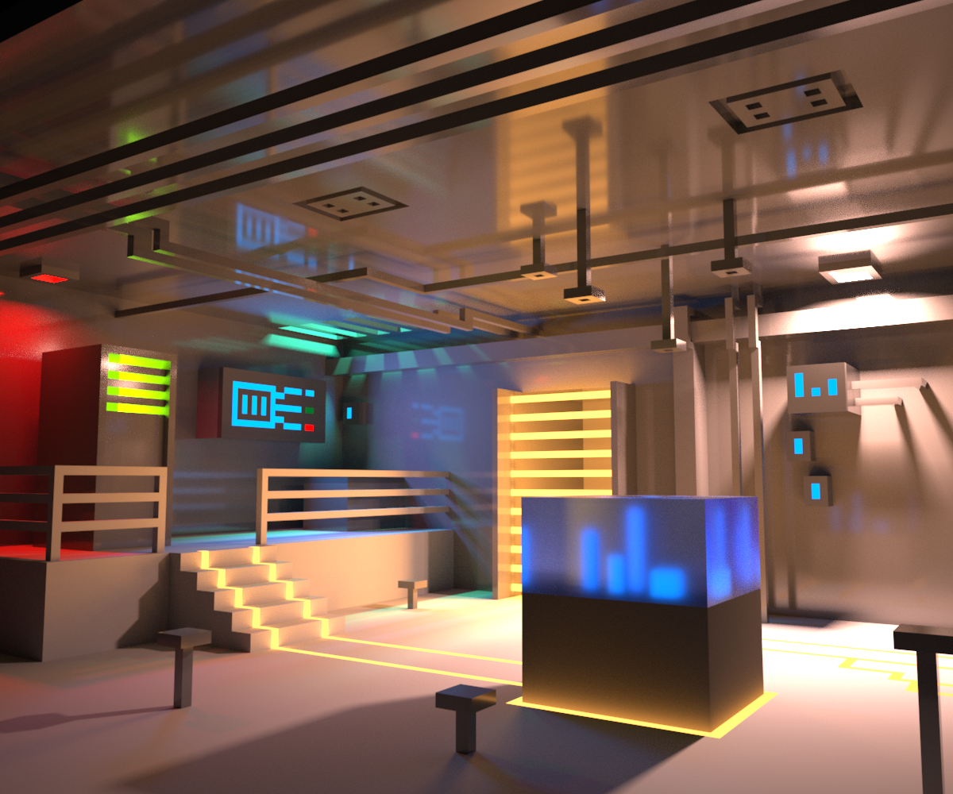
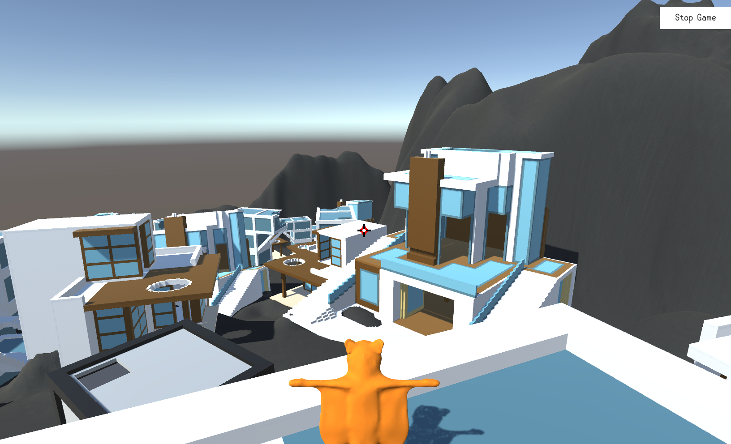


What does it look like?
REPLACE THIS PICTURE WITH MORE
RECENT BUILD

Slide 7
The Gameplay
*Gameplay vids/gifs go here*

Slide 8
Feedback
"Gliding is pointless - too slow"
"Grapple needs cooldown"
"It's cool though"
"Camera placement is strange"
"Art style works"
"Allow jump at end of grapple"
GET MORE RECENT/RELEVANT FEEDBACK

Slide 9
Going forward
Level design changes/iterations.
Lighting/layout/guidance.
UI design and implementation
Further playtesting

Slide 10
Questions?
Elliot Page – Max Carter – Zachari Cooper – Rebecca Brannum – Joe Wilson

